Slide 1

CP-302 CAPSTONE PROJECT
Enhancing heat transfer using elastic turbulence in concentric rotating cylinders
PROJECT GUIDE:
DR. CHANDI SASMAL
ASSISTANT PROFESSOR
MAYANK KUMAR
2020CHB1045

Slide 2
CONTENTS
PROBLEM STATEMENT
LITERATURE SURVEY
SCOPE OF PROBLEM
RESOURCES USED
FUTURE PLAN

Slide 3
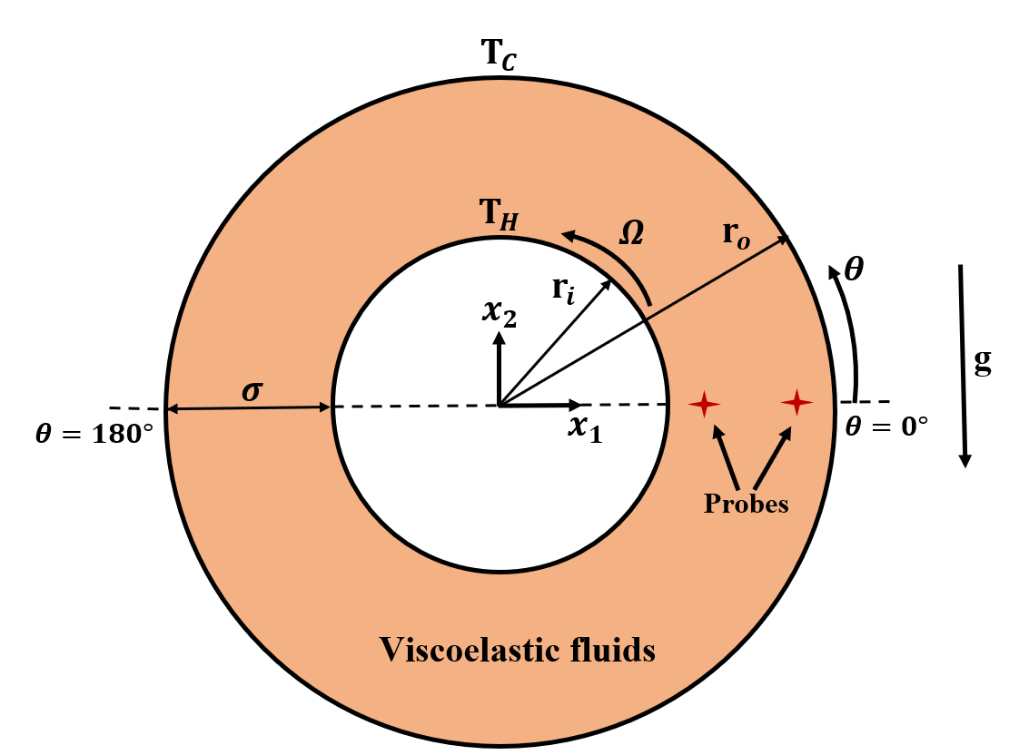
PROBLEM STATEMENT
Mixed convection heat transfer of viscoelastic fluids within a horizontal concentric annulus with inner rotating cylinder (also known as “Taylor-Couette Flow”) is investigated in detail.

Slide 4


Governing Equations
Continuity Equation:
Momentum Equation:
Energy Equation:
$$∇.u=0$$
$$ρ\left(\frac{∂u}{∂t}+u.∇u\right)=−∇p+∇.τ+ρgβ_{T}\left(T−T_{ref}\right)e_{2}$$
$$ρC_{p}\left(\frac{∂T}{∂t}+u.∇T\right)=∇.(K∇T)$$

Slide 5

BOUNDARY CONDITIONS
Inner cylinder:
Velocity: Rotating with an angular velocity of $Ω$ in anticlockwise direction.
Pressure: fixedFluxPressure
Outer cylinder:
Velocity: Held stationary
Pressure: fixedFluxPressure

Slide 6
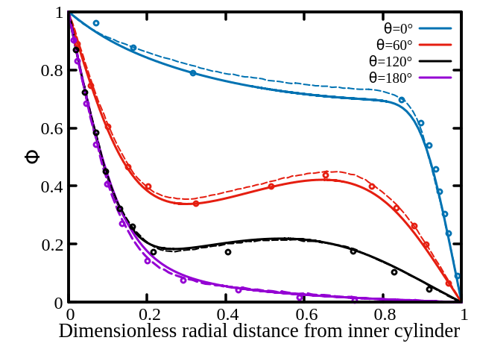
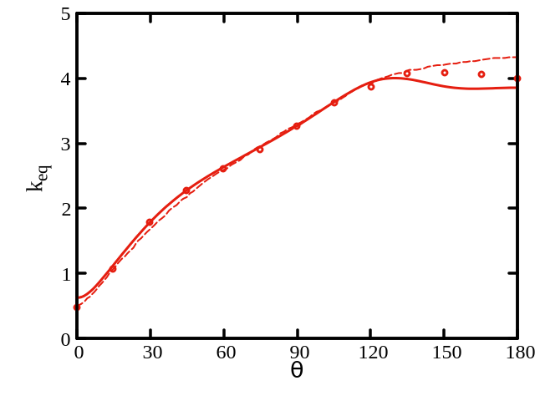
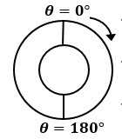
LITERATURE SURVEY
T. H. Kuehn, R. J. Goldstein, An experimental and theoretical study of natural convection in the annulus between horizontal concentric cylinders, J. Fluid Mech. (1976) 74, 695-719.

Slide 7
LITERATURE SURVEY
Joo-Sik Yoo, Mixed convection of air between two horizontal concentric cylinders with a cooled rotating outer cylinder, Int. J. Heat Mass Transfer (1998) 41(2), 293-302.
Re | Ra | Gr | Average Nusselt number
 |  |  | Present | Yoo (1998) | %Error
100 | 1000 | 1428.571429 | 1.009624667 | 1.00717 | 0.2437192798
100 | 3000 | 4285.714286 | 1.144353612 | 1.15825 | 1.199774468
150 | 3000 | 4285.714286 | 1.025171424 | 1.02131 | 0.3780854432
200 | 3000 | 4285.714286 | 1.013230714 | 1.00672 | 0.6467253646
100 | 7000 | 10000 | 1.608313061 | 1.60856 | 0.01535154175
150 | 7000 | 10000 | 1.474254149 | 1.49661 | 1.493765947
200 | 7000 | 10000 | 1.326829492 | 1.12332 | 18.11678703
316 | 7000 | 10000 | 1.010291226 | 1.01615 | 0.5765658702
100 | 10000 | 14285.71429 | 1.806580407 | 1.80226 | 0.2397216062
150 | 10000 | 14285.71429 | 1.7097648 | 1.72421 | 0.8377865753
200 | 10000 | 14285.71429 | 1.596271673 | 1.58337 | 0.8148236521
250 | 10000 | 14285.71429 | 1.431271865 | 1.41357 | 1.252280763
400 | 10000 | 14285.71429 | 1.018737361 | 1.00613 | 1.253054882

Slide 8
LITERATURE SURVEY-cont’d
Re | Ra | Gr | Average Nusselt number
 |  |  | Present | Yoo (1998) | %Error
100 | 20000 | 28571.42857 | 2.214993744 | 2.21874 | 0.1688460834
200 | 20000 | 28571.42857 | 2.082939818 | 2.087 | 0.1945463239
400 | 20000 | 28571.42857 | 1.511998109 | 1.48556 | 1.779672921
500 | 20000 | 28571.42857 | 1.053337852 | 1.03002 | 2.263825147
700 | 20000 | 28571.42857 | 1.019311916 | 1.0102 | 0.9019913166
100 | 50000 | 71428.57143 | 2.825735291 | 2.8192 | 0.2318136876
200 | 50000 | 71428.57143 | 2.747755318 | 2.75044 | 0.09760917162
400 | 50000 | 71428.57143 | 2.356950818 | 2.32331 | 1.4479694
500 | 50000 | 71428.57143 | 2.101686274 | 2.0373 | 3.160372735
800 | 50000 | 71428.57143 | 1.409317604 | 1.32477 | 6.382059053
900 | 50000 | 71428.57143 | 1.056614855 | 1.03889 | 1.706133952

Slide 9
LITERATURE SURVEY
T. S. Lee, Numerical Experiments with laminar fluid convection between concentric and eccentric heated rotating cylinders, Numerical Heat Transfer (1998) 7, 77-87.
Configuration | Ra | Nu_Present | Lee | % Error
Stationary concentric cylinders | 10000 | 1.979720617 | 1.99336 | 0.6842408225
 | 50000 | 2.962250633 | 3.10353 | 4.552215271
 | 100000 | 3.468425581 | 3.65931 | 5.21640471

Slide 10
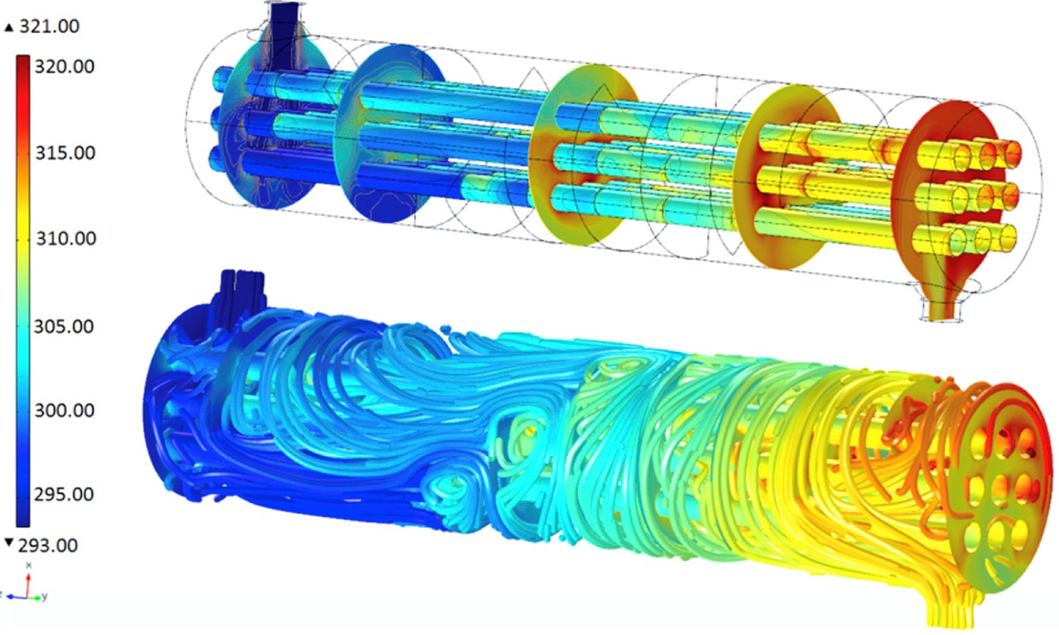
SCOPE OF PROBLEM
Important for theoretical & practical engineering applications such as:
Heat exchangers, nuclear reactor design, equipment cooling in electronics sector, thermal solar collectors, etc.

Slide 11
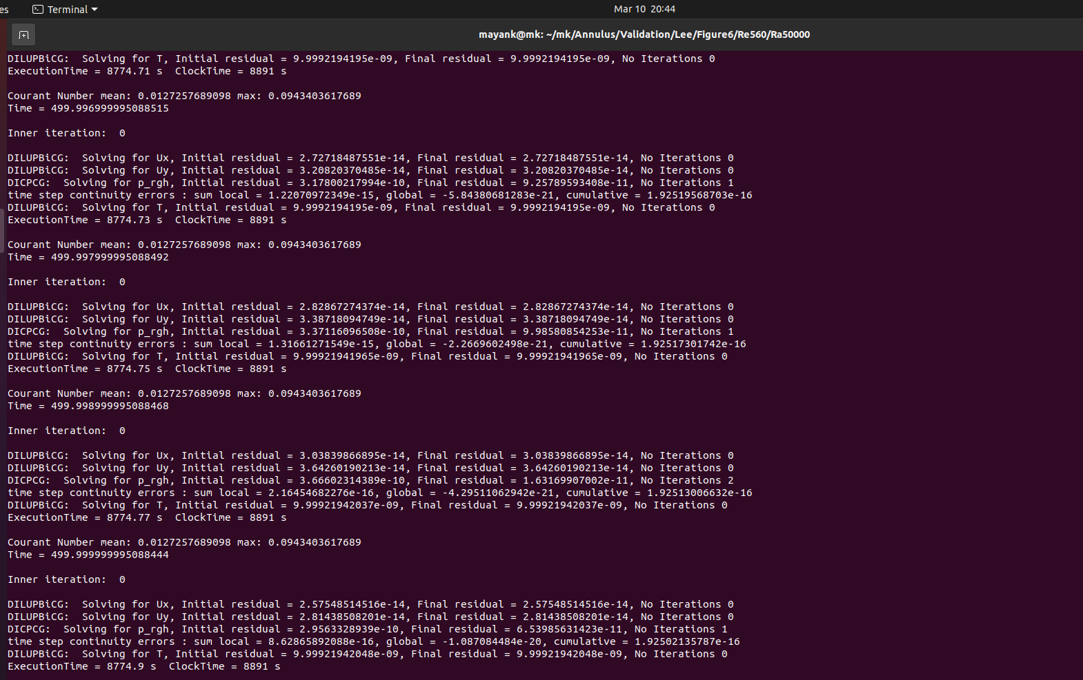
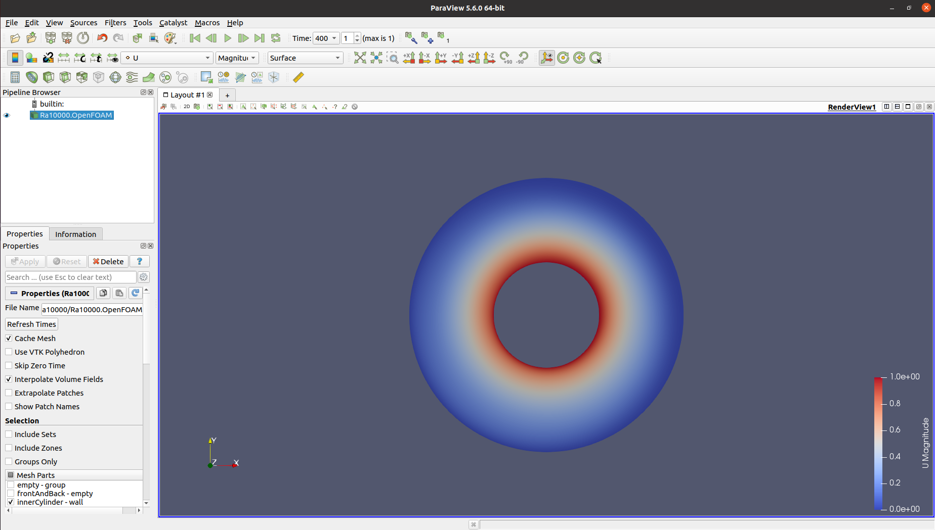
RESOURCES USED
Open-sourced CFD software OpenFOAM and visualisation tool ParaView.
Notes:
Computational Fluid Dynamics (CFD) refers to computational calculation of the motion and forces of the flow using numerical analysis.

Slide 12

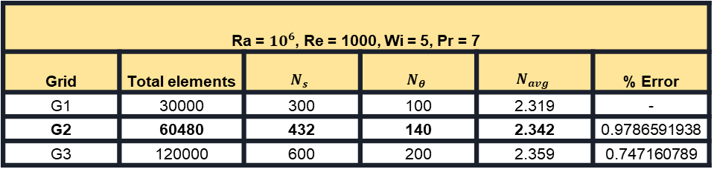
FUTURE PLAN
Grid Independence Study
Ra = $10^{6}$, Re = 1000, Wi = 5, Pr = 7
Grid | Total elements | $$N_{s}$$ | $$N_{θ}$$ | $$N_{avg}$$ | % Error
G1 | 30000 | 300 | 100 | 2.319 | -
G2 | 60480 | 432 | 140 | 2.342 | 0.9786591938
G3 | 120000 | 600 | 200 | 2.359 | 0.747160789
Perform extensive amount of numerical simulations for various dimensionless numbers at fixed value of $Pr=7$ using grid G2 and compare the results:
$${10}^{3}≤Ra≤{10}^{6}; 100≤Re≤1000; 0≤Wi≤5$$

Slide 13
THANK YOU!

